Slide 1

Exploratory Data Analysis presentation on the US Shootings
Joshua Sebu, Akua Gyanba Morgan Acquah & Gabriel Assamah

Slide 2
Hypothesis
More blacks are shot than any race
Youth are more likely to be shot than the older people
People are more likely to be shot when they are armed
Those who were shot showed sign of mental illness
Victims are most likely shot because they attacked the policeman
Victims that were fleeing were more likely to be shot
Policemen with body camera were less likely to shoot their victims

Slide 3
Research Questions
Are blacks more likely to be shot than any other race?
Are youths more likely to be shot than the older people?
What is the possibility that people are more likely to be shot when they are armed?
Do the police still shot victims who show signs of mental illness?
Were victims shot because they were attacked the policeman?
Were victims shot because they were fleeing?
Are the policemen less likely to shoot when he wears body camera?

Slide 4
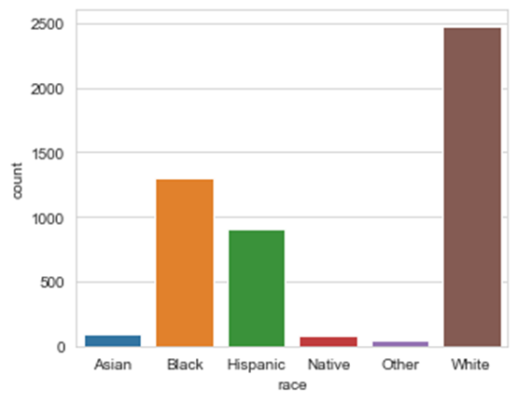
Figure 1: Distribution of race of victims of shooting
Whites were shot more than any other race.

Slide 5
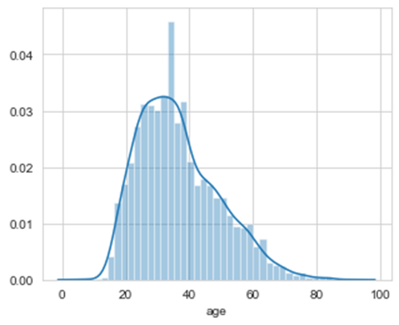
Figure 2: Distribution of age of shooting victims
The distribution shows a positive skewness of the data implying that more victims were in their youthful age. As shown majority of the victims were below 40 years.

Slide 6
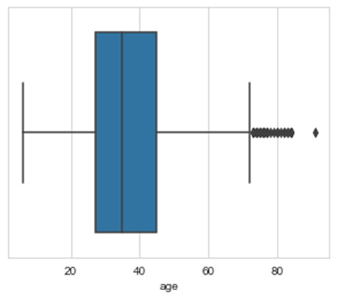
Figure 3: Boxplot showing outliers of age of victims
The figure shows clearly that there are outliers at older ages just above approximately 72 years.

Slide 7
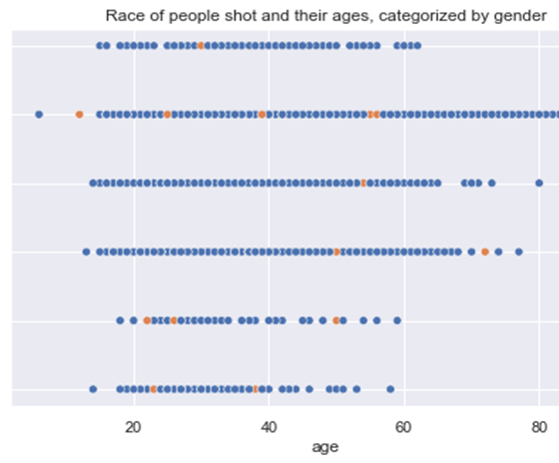
Figure 4: Race of people shot and their ages, categorized by gender
More Males than females were shot, more whites were shot and outliers were discovered. Both the minimum and maximum ages were of the white race.

Slide 8
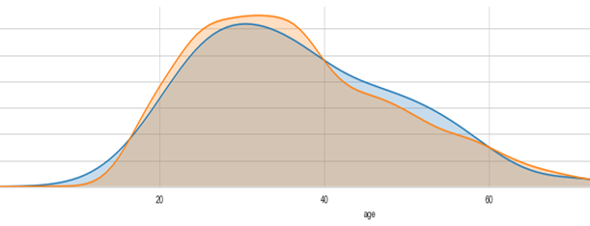
Figure 5: Proportional distribution of age of victims by sex
The figure shows that more proportion of women below 18 years were killed compared to their male counterparts of the same age. This was also true for ages between 40 and 60 years.

Slide 9
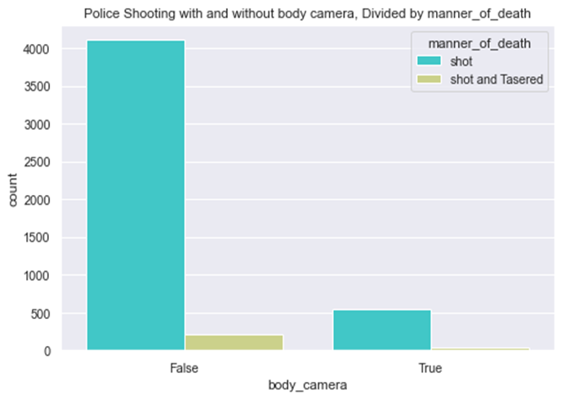
Figure 6: Police Shooting with and without body camera, by manner of death
Most of the shooting were carried out by policemen who had no body camera on them compared with their counterparts who did have body camera on them.

Slide 10
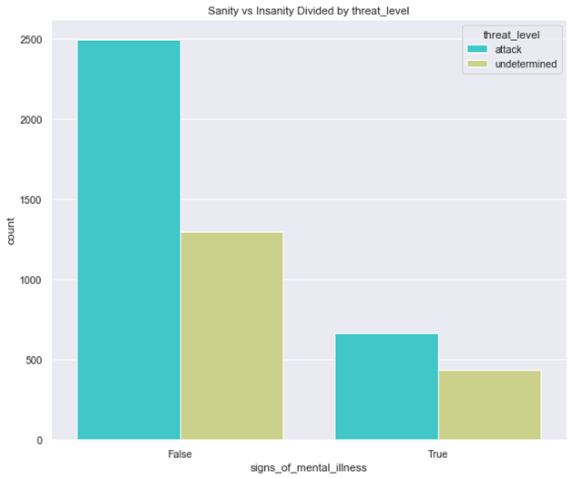
Figure 7: Distribution of sanity of victims by their threat level
Figure 7 shows that most victims whether showing signs of sanity or not tried attacking the policeman who shot and killed them.

Slide 11
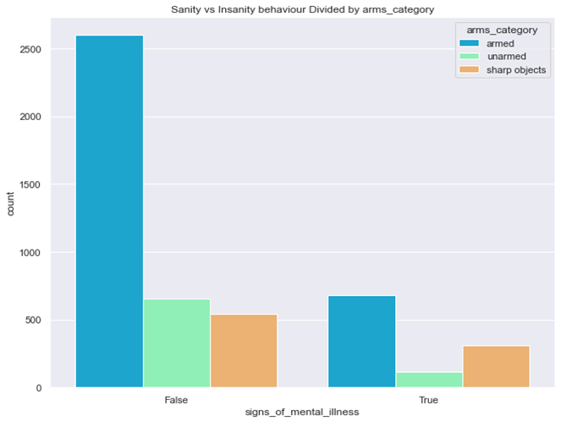
Figure 8: Distribution of sanity of victims by whether they were armed or not
Findings show that majority of both sane and mentally unstable victims who were shot were armed

Slide 12
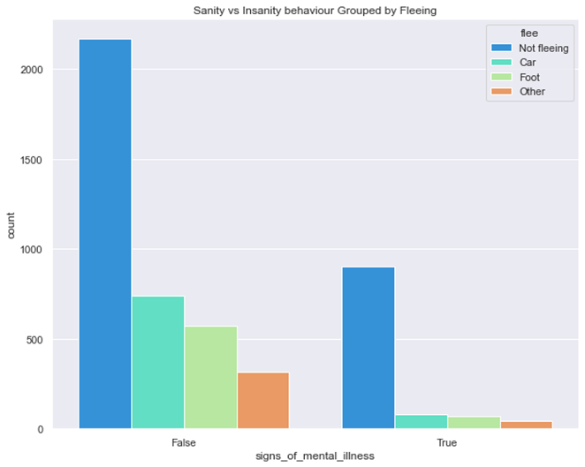
Figure 9: Distribution of sanity of victims by whether they were fleeing or not
Most of the shot victims were not fleeing.
Those who showed no sign of mental illness and tried fleeing, majority attempted fleeing by car followed by foot

Slide 13
Conclusion
Despite the popular opinion, more whites are the victims of police shootings.
The youth are the greatest victims of police shooting.
Majority of those shot were armed and allegedly attacked the policeman.
Majority of victims were shot while fleeing
Most victims showed no sign of mental illness
Policemen with body camera were less likely to shoot their victims.

